Slide 1

课时练习
期末复习四 模块八 第一章

Slide 2
一、 词汇。
(A)根据语境、音标或所给单词的提示完成句子，每空一词。
1. A cook ________ (lose) his hearing because of a wound(伤口) on his hand.
2. People in the north are usually warmly dressed in coats and ______________ (scarf) in winter.
3. This kind of paper is not __________ /smuːð/ enough.
lost
scarves/scarfs
smooth

Slide 3
一、 词汇。
(A)根据语境、音标或所给单词的提示完成句子，每空一词。
4. My grandparents live in the countryside and they have a _________ /'sɪmpl/ lifestyle.
5. The tall man looks very __________ in a black jacket. He looks like a superstar.
simple
handsome

Slide 4
一、 词汇。
(B)用括号内所给单词的适当形式填空，每空一词。
1. The girl started to run her own __________ (busy) at an early age.
2. The teacher used a great example to show the _________ (mean) of the new word.
3. The room was cold, but it _________ (afford) us a fine view(景色) of the city.
business
meaning
afforded

Slide 5
一、 词汇。
(B)用括号内所给单词的适当形式填空，每空一词。
4. The movie is so ___________ (interest) that I want to watch it once again.
5. There are many regular __________ (customer) at the Chinese braised chicken(黄焖鸡) restaurant.
interesting
customers

Slide 6
二、 重点句型。
1. 这手提包太贵了，以至于这位女士买不起。
The handbag is ________________ the woman _______________.
2. 这是如此酷的一件风衣，你应该立刻买下它。
It’s such ______________________ you should buy it __________.
so expensive that
can’t afford it
a cool windbreaker that
at once

Slide 7
二、 重点句型。
3. 帮助人们选择合适的衣服对你来说很重要。
It’s _______________ you ______________________
____________________________________________.
4. 我希望你生意兴隆。
I hope your __________________________________.
5. 但在今天，服装不仅仅是用来给我们保暖的。
But nowadays, clothes do ______________________
____________________________________________.
important for to help people choose suitable clothing/clothes
business goes/does well
more than just keep us warm

Slide 8
三、重点语法。
★ so … that …, such … that … 和so that的用法
(A)根据所学知识, 将横线上的内容补充完整。
●so … that … 表示 “如此……以至于……”， 常用于引导 _______ 状语从句。常见结构为： so+________ / ________+that从句。如：He was so tired that he couldn’t walk further any more.
结果
形容词
副词

Slide 9
三、重点语法。
●such … that … 表示 “如此……以至于……”， 常用于引导 _______ 状语从句。常见结构为： such+a/an+形容词+可数名词 ______ 数+that从句/such+形容词+可数名词 ______ 数/ ________ 数名词+that从句。如：
They were such difficult problems that all of us couldn’t work them out.
结果
单
复
不可

Slide 10
三、重点语法。
注意：如果名词前用many, much, little, few等表示数量的词修饰时, 要用so。如：
There are so many people that we can’t find a good place to take photos.
●so that意为 “因此, 所以”, 引导 _______ 状语从句； so that 还可以引导 _______ 状语从句, 此时意为 “以便, 为了”。 如：
The father works hard so that his children can live happily.
结果
目的

Slide 11
三、重点语法。
(B)根据中文提示完成英语句子。(每条横线不限词数。)
1. 他起得很早，赶上了早班车。
He got up _____________________ the early bus.
2. 这是如此有意义的一本书，以至于我想再读一遍。
It’s such ____________________ I want to read it again.
so early that he caught
a meaningful book that

Slide 12
三、重点语法。
(B)根据中文提示完成英语句子。(每条横线不限词数。)
3. 我常常多吃蔬菜少吃肉，以便能更健康。
I often eat more vegetables and less meat __________
_____________________________________________.
4. 他们是如此可爱的孩子，我们都喜欢他们。
They are _______________________ that we all like them.
so that I can be healthier
such lovely/cute kids

Slide 13
三、重点语法。
(B)根据中文提示完成英语句子。(每条横线不限词数。)
5. 瓶子里的水如此少，以至于我要再去买一瓶。
There is _____________ in the bottle that I need to buy another bottle.
so little water

Slide 14
四、单项选择。
( )1. It’s _________ a funny story __________ we can’t help laughing every time we hear it.
A. so; that B. such; that C. too; to
B

Slide 15
四、单项选择。
( )2. It’s quite necessary to ________ masks(口罩) and do temperature checks during COVID-19.
A. dress B. wear C. put up
B

Slide 16
四、单项选择。
( )3. People used to _________ much for a smartphone, but now it’s much cheaper.
A. spend B. cost C. pay
C

Slide 17
四、单项选择。
( )4. Reading can do more than just ________ people clever.
A. make B. to make C. making
A

Slide 18
四、单项选择。
( )5. He works hard ____________ he can get good results in the final exam.
A. in order B. in case C. so that
C

Slide 19
四、单项选择。
( )6. —Why don’t you take the T-shirt, Linda?
—I only have $10. I can’t _________ it.
A. borrow B. afford C. buy
B

Slide 20
四、单项选择。
( )7. —Could you tell me __________ this camera?
—Sure. It’s very easy.
A. where to use B. when to use C. how to use
C

Slide 21
四、单项选择。
( )8. — _________of shoes do you want to buy?
— Size 38.
A. What style B. What size C. What color
B

Slide 22
四、单项选择。
( )9. —What a sunny day!
—Yes. You’d better take a sun umbrella to
_______ yourself _______ the strong light.
A. stop; from B. get; from C. protect; from
C

Slide 23
四、单项选择。
( )10. —Shall we go mountain climbing this weekend?
— ______________！
A. All right B. Never mind C. What a pity
A

Slide 24
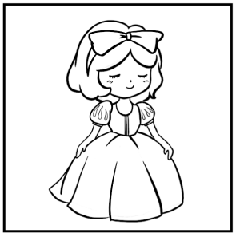
五、看图写话。
1. look, in
The girl/She looks nice in the dress.

Slide 25
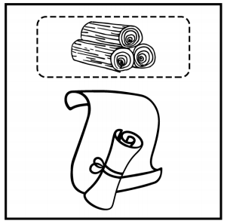
五、看图写话。
2. be, made
Paper is made from wood.

Slide 26
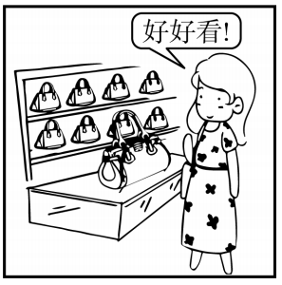
五、看图写话。
3. such, buy
It’s such a beautiful handbag that she wants to buy it.

Slide 27
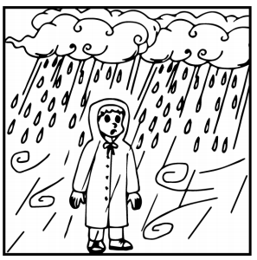
五、看图写话。
4. raincoat, protect
The raincoat protects the man from the rain./
Raincoats can protect people from the rain.

Slide 28
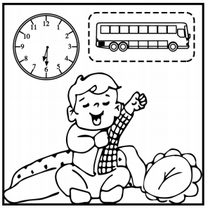
五、看图写话。
5. always, so that
The boy/He always gets up early so that he can catch the (early) bus.

Slide 29
六、短文填空。
Alain Robert is a Frenchman. He is good 1 climbing tall buildings. He is called the “Spiderman(蜘蛛侠)”. So far, he has climbed over 100 buildings, including(包括) the Burj Khalifa and the Eiffel Tower.
One day, he went to Barcelona(巴塞罗那) to climb one of its 2 (tall) towers, the Torre Agbar, without a harness(背带). The Torre Agbar is the 3 /θɜː(r)d/ tallest building in Barcelona.
at
tallest
third

Slide 30
六、短文填空。
It is a 38-floor building. Some 4 /pə'liːs/ officers went to the Torre Agbar and watched Alain Robert climb. He 5 about an hour finishing the climbing. After he climbed back from the 38-floor building, the officers 6 /'kwɪkli/ ran up to him and took him away. They worried 7 his safety because there were so many people around him.
police
spent
quickly
about

Slide 31
六、短文填空。
There were a lot of fans and reporters 8 (stand) at the bottom(底部) of the Torre Agbar. They were waiting for Robert. They took 9 (photo) of the great climber and they greeted him with cheers.
Alain Robert’s climbing will go on as he plans to go to other 10 (country) to climb more high buildings.
standing
photos
countries

Slide 32
七、完形填空。
As an old Chinese saying goes, “Out with the old, in with the new.” But when you buy some new clothes， how will you 1 your old clothes?
Years ago, used clothes got 2 to younger brothers or sisters in one family. But now, some of us are the 3 child in the family, so we often wear new clothes.
1. A. deal with B. play with C. solve with
2. A. sold B. passed C. dressed
3. A. only B. last C. first
A
B
A

Slide 33
七、完形填空。
And people are buying more clothes 4 they are richer than before. It’s a pity that every year in China, people 5 about 26 million tons(吨) of old clothes.
In many areas, charity(慈善) shops collect and resell second-hand clothes. And people often shop for used clothes at charity shops.
4. A. so B. but C. because
5. A. throw away B. keep away C. leave away
C
A

Slide 34
七、完形填空。
A famous British singer once said, “Here is a(n) 6 I want more people to know about: used clothes are not useless. We can give them away to people in need or use them to make 7 like toys.”
Few Chinese cared about fashion years ago, but now more and more people show 8 .
6. A. advice B. story C. message
7. A. rules B. things C. plans
8. A. interest B. surprise C. worries
C
B
A

Slide 35
七、完形填空。
Yishion(以纯), a fashion clothing brand(品牌)， is inviting people 9 their used clothes into special boxes in its 45 stores in China. They resell some of the clothes at a lower price 10 cleaning them, so people don’t have to worry about any health problems. This helps to cut down on resource waste(资源浪费) and save people money.
9. A. putting B. put C. to put
10. A. before B. until C. after
C
C

Slide 36


